Slide 1

Inheritance
M1-D11
Participate! The more engagement the better! You are NEVER interrupting me!

Slide 2
Week at a glance
Tuesday: OOP - Inheritance Wednesday: OOP - Polymorphism (via Inheritance/Interfaces) Thursday: OOP - Inheritance(part 2/Abstract classes) Friday: Testing Phases / Unit Testing(JUNIT)

Slide 3
Objectives
Defining Inheritance
Specialization and is-a
Implementing inheritance
Polymorphism with inheritance
BigDecimal

Slide 4



3 Fundamental Concepts of OOP
Encapsulation - the concept of hiding values or state of data within a class, limiting the points of access.
Inheritance - the practice of creating a hierarchy for classes in which descendants obtain the attributes and behaviors from other classes classes.
Polymorphism - the ability for our code to take on different forms. In other words, we have the ability to treat classes generically and get specific results.
The key starts the car. The Ignition system is hidden from the user turning the key to start the car.
Vehicle
Has wheels
Has Steering wheel
(what else?)
car
Truck

Slide 5
Inheritance
Enables a class to take on the properties and methods defined in a parent or ancestor’s class. The subclass will inherit all visible properties and methods from the superclass while having the ability to add its own.
A subclass is the derived class acquiring the properties and behaviors from a superclass (parent, ancestor).
A superclass is the base class whose members are being passed down.
Except for Object which is the starting ancestor of all classes in Java, ALL classes in Java have ONE and ONLY ONE direct superclass, which is called Single Inheritance. If a class does not have an explicit superclass, then it is implicitly a subclass of Object

Slide 6
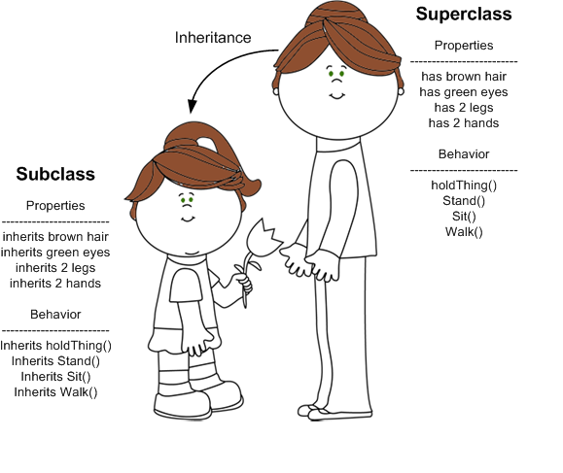
Inheritance
A subclass inherits all visible (non-private) properties and behaviors (methods) from the superclass.
A subclass DOES NOT inherit private properties or methods from the superclass. (but can inherit any public getters/setters.
Constructors are NOT inherited.
The subclass will then pass these traits through each subsequent generation, if it becomes a superclass to its own subclasses.
A Superclass can have multiple subclasses, however, a subclass may only have 1 superclass.

Slide 7
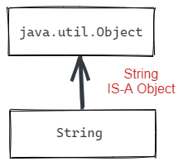
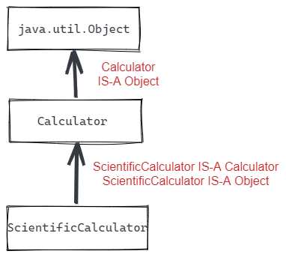
Object
In Java, all Objects (Reference Types) are subclasses of the class java.lang.Object. Object is the only class in Java that does not have a superclass.
The only things in the language that are not descendents of java.lang.Object are the primitives: long, int, double, boolean, etc.
Even if no superclass is specified, all classes still implicitly extend from java.lang.Object, and inherit a set of common methods, such as:
.toString()
.equals()
.hashCode()

Slide 8
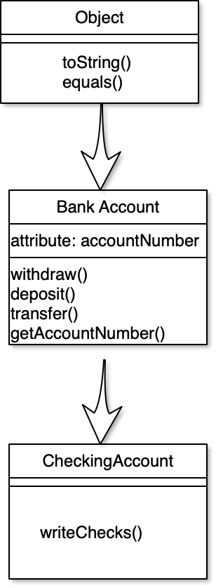
Inheritance
BankAccount is-a Object
BankAccount inherits:
toString()
equals()
CheckingAccount is-a BankAccount
CheckingAccount inherits:
toString()
equals()
withdraw()
deposit()
transfer()
getAccountNumber()

Slide 9
Guitar Example?

Slide 10
Vehicle Example?

Slide 11
Bike Example?

Slide 12
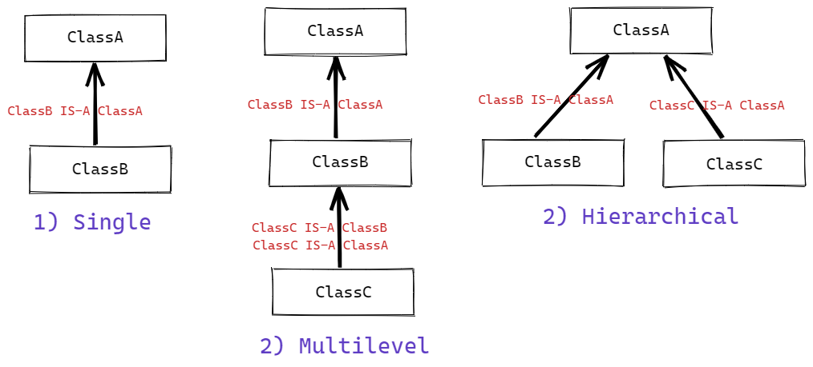
Types of Inheritance in Java

Slide 13
Casting to a superclass (upclassing)
Objects can be cast to any superclass type in their hierarchy. Casting to a superclass is called Upclassing.
Upclassing is widening, so it is implicit (automatic).
CheckingAccount checking = new CheckingAccount(); BankAccount bankAccount = checking;
Object obj = bankAccount;
Casting changes the way we view and use the object, but not the object itself. When an object is cast as another object in its hierarchy, then it can be treated as the object it is cast as, and will only have the methods and properties available to that type.

Slide 14
Casting to a subclass (downcasting)
Objects can be cast to any of their subclass types, called Downcasting, provided that internally the Object is already that subclass type. Downcasting is narrowing, so must be explicit.
CheckingAccount checking = new CheckingAccount(); BankAccount bankAccount = checking;
CheckingAccount backToCheckingAccount = (CheckingAccount) bankAccount;
If the Object is not internally the subclass type it is being cast as, then it will result in a ClassCastException runtime error
BankAccount bankAccount = new BankAccount(); CheckingAccount checkingAccount = (CheckingAccount) bankAccount;
Object obj = new Scanner(); String s = (String) obj;
ClassCastException

Slide 15
Casting
When an object is downcast or upcast to another class in its hierarchy it will only have access to the properties or methods available on the type it is cast to, and will not have access to any of its own subclass specific methods or properties.
Casting an object to a different type in its hierarchy, only changes how the object is being treated, and does not change the object or what it internally is.
CheckingAccount checkingAccount = new CheckingAccount(); BankAccount bankAccount = checkingAccount; Object obj = bankAccount;
In the code above, checkingAccount is instantiated as a CheckingAccount and then upcast to a BankAccount and then Object. However, in all cases the object is still internally a CheckingAccount, even when it is cast and being treated as one of its superclasses.

Slide 16
Constructors
Constructors are not inherited. If the superclass has a constructor with arguments, then the subclass must invoke the superclass’s constructor to provide the values.
The super keyword can be used to invoke the superclass’s constructor
public class Coin {
private int value;
public Coin(int value) {
this.value = value;
}
}
public class Quarter extends Coin {
public Quarter() {
super(25);
}
}

Slide 17
Method Overriding
Inherited methods can be Overridden to provide functionality that is specific to the subclass. The super keyword can be used in the subclass to invoke the super class’s version of an overridden method. To Override a superclass method, a method with an identical method signature is added to the subclass.
public class Account {
double balance;
...
public void deposit(int amount) {
balance += amount;
}
}
public class CheckingAccount {
...
@Override
public void deposit(int amount) {
amount -= depositFee;
super.deposit(amount);
}
}

Slide 18
BigDecimal
java.Math.BigDecimal
https://docs.oracle.com/javase/7/docs/api/java/math/BigDecimal.html
Does not have a floating point rounding problem like double and float. Does not truncate like integer. Is commonly used for currency and other calculations that require a high and precise significance of precision.
import java.math.BigDecimal;
BigDecimal amount = new BigDecimal(<value>); ← CANNOT use a No-Argument Constructor
Can’t use operators +, - , %, /, *, <, etc. instead use methods
example: amount.add()
BigDecimal is immutable.
BigDecimal amountOne = new BigDecimal(100.50);
BigDecimal amountTwo = new BigDecimal(200.25);
BigDecimal combinedAmount = amountOne.add(amountTwo);
In the above code, when add is called the value of amountOne is not changed, it remains 100.50. Instead a new BigDecimal is returned with the sum (300.75). This is due to BigDecimal being immutable, and is the same as when you use a String function like substring() or toUpperCase()

